Slide 1

Analyze reviews With the help of a.I.
Hasan haq
Notes:
*5 star system is broken
*Believe there is a better way with AI

Slide 2
Smart consumers read reviews, but we can’t analyze all of them.
Notes:
*What do we do when we have to make an important decision and all reviews favorable?
*Skim through and read bits
*Can’t analyze all

Slide 3
Irrelevant
Subjective
Incomplete
Inaccurate
Subjective
Polarized
Source: http://minimaxir.com/2014/09/one-star-five-stars/
Notes:
*Here’s the kind of stuff we are looking for when skimming
*We would not put much weight on these reviews

Slide 4
Let a computer do all the work with Riffle.
Notes:
*Using machine learning, I created a web app that can do this
*It looks through reviews the way a human would, and puts weights on differnet features

Slide 5
Yelp Dataset
4.1mm reviews
144k businesses
USA, UK, Germany, Canada
Proportion of Reviews by Star Ratings
Notes:
*This is the dataset that I used
*Reviews are TOO FAVORABLE
*We need to knock out the fluff

Slide 6
Let Riffle Do It
Train on 1 and 5 Star Reviews
Assign Simple Ratings
Add Penalties
Populate SQL Database
Deploy to Web App
Object Oriented Python
F1 Scores
XGBoost: 95%
Naïve Bayes: 93%
Random Forests: 92%
NLTK
TextBlob
AWS
Postgresql
Psycopg2
Flask
Apache
Notes:
*The first step was to get rid of the ambiguity in 2-4 star ratings
*So I trained models on text of 1 and 5 star reviews to learn how language is favorable or not
*With that model, I assigned new ratings to all reviews

Slide 7
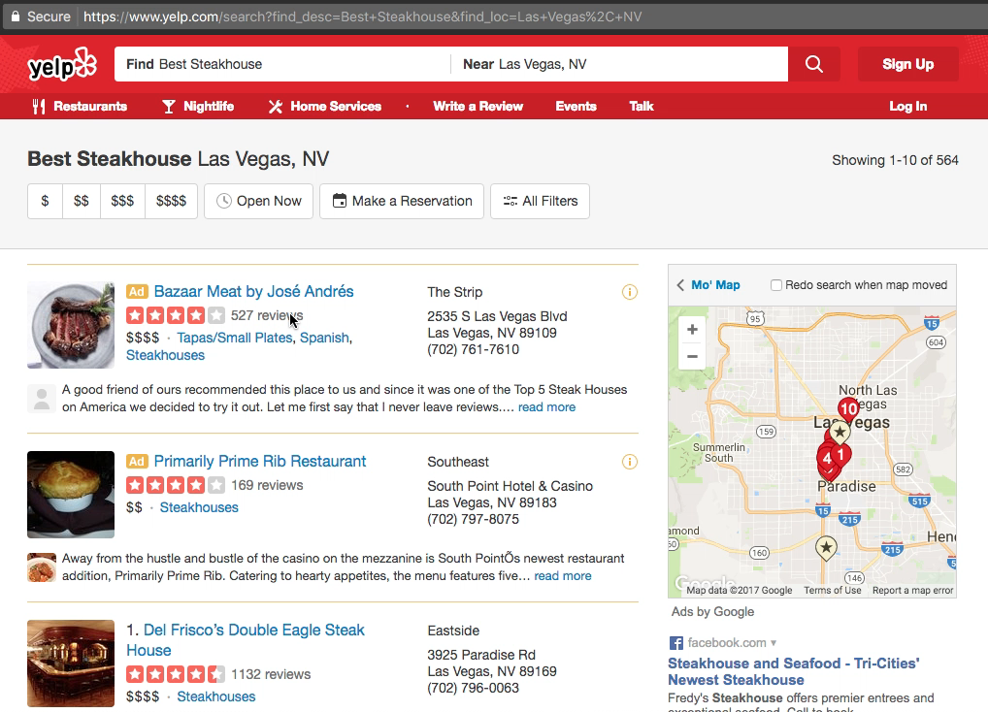
Riffle Product Demo

Slide 8

Thank you!
Hasan Haq
hasan.haq@gmail.com
http://riffle.hasanhaq.com
Notes:
*Website is currently live and working now

